Slide 1
Microeconomics
Economies of Scale

Slide 2
Economies of Scale
Economies of scale refer to the cost advantage experienced by a firm when it increases its level of output.
The advantage arises due to the inverse relationship between per-unit fixed cost and the quantity produced.
The greater the quantity of output produced, the lower the per-unit fixed cost.

Slide 3
EoS- Is it only reduction in Fixed Cost?
Economies of scale also result in a fall in average variable costs (average non-fixed costs) with an increase in output.
This is brought about by operational efficiencies and synergies as a result of an increase in the scale of production.

Slide 4
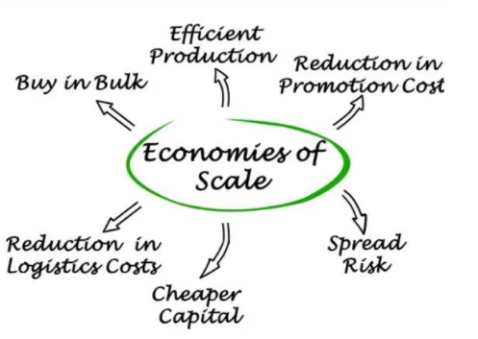
Other ways to Achieve EoS:

Slide 5
EoS can be realized at any stage of the production process.
Thus, a business can decide to implement economies of scale in its marketing division by hiring a large number of marketing professionals.
A business can also adopt the same in its input sourcing division by moving from human labor to machine labor.

Slide 6
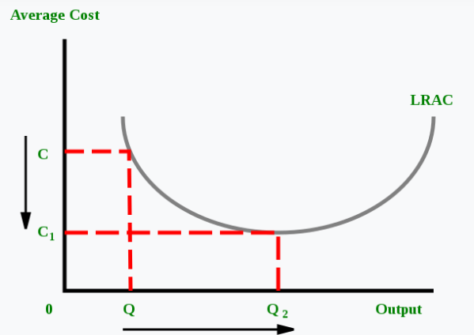
Effects of Economies of Scale on Costs
It reduces the per-unit fixed cost.
It reduces per-unit variable costs. This occurs as the expanded scale of production increases the efficiency of the production process.

Slide 7
Types of EoS
Types of Economies of Scale
1. Internal Economies of Scale
This refers to economies that are unique to a firm. For instance, a firm may hold a patent over a mass production machine, which allows it to lower its average cost of production more than other firms in the industry.
2. External Economies of Scale
These refer to economies of scale enjoyed by an entire industry. For instance, suppose the government wants to increase steel production. In order to do so, the government announces that all steel producers who employ more than 10,000 workers will be given a 20% tax break. Thus, firms employing less than 10,000 workers can potentially lower their average cost of production by employing more workers. This is an example of an external economy of scale – one that affects an entire industry or sector of the economy.

Slide 8
Sources of Economies of Scale
1. Purchasing
Firms might be able to lower average costs by buying the inputs required for the production process in bulk or from special wholesalers.
2. Managerial
Firms might be able to lower average costs by improving the management structure within the firm. The firm might hire better skilled or more experienced managers.
3. Technological
A technological advancement might drastically change the production process. For instance, fracking completely changed the oil industry a few years ago. However, only large oil firms that could afford to invest in expensive fracking equipment could take advantage of the new technology.

Slide 9
Dis-Economies of Scale
Dis-Economies of Scale: Increasing output & the cost also Increases.
The Increase in Output from Q2 will lead to Dis-Economies.

